Slide 1


Fantasy football
De Anza College
CIS 22C – Spring 2016
Team 4

Slide 2

Team 4 Members
Kevin Nguyen
ka u ieong
bret farley
minting ye

Slide 3
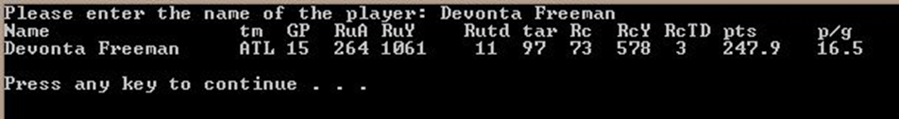
Why Fantasy Football?
Each fantasy football team is made up of real NFL players
Player stats in real games correlate to fantasy points
Whoever has more fantasy points wins the “game”
HUGE amounts of player stats to track and calculate
Example: “Devonta Freeman” – Runningback for Atlanta Falcons

Slide 4
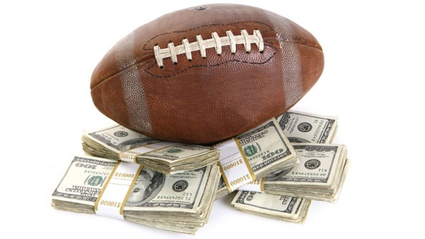
Why Fantasy Football?
In 2015, there are 56.8 million people playing fantasy sports in the USA and Canada.
The $70 Billion Fantasy Football Market

Slide 5

A brief introduction of the program
Purpose: Database to store, retrieve, and sort players quickly
Currently limited to just running backs; but will be able to expand to other positions
Functions:
Add new data
Delete data
Find data
List hash sequence
List sorted data
Print indented tree
Print efficiency
Compare players

Slide 6
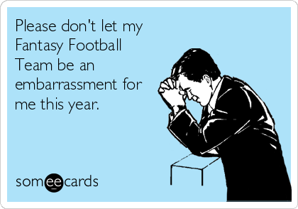
Assignments
Kevin – Team Lead
Program Integration
Code Main Menu (main.cpp)
Assist HASH/BST coding and creating structure chart
Create Test Demonstration
Johnny – I/O
File input/output
User input/output
Program Integration
Minting – HASH
Code hash table
Create DSD and structure chart
BRET – BST/AVL
Code BST/AVL
Data Record
Presentation Outline

Slide 7
data structure diagram
Fantasy football

Slide 9
key design efficiencies
Load Factor/Average number of nodes in linked lists: 1.724
Longest Linked List: 5
Easy and fast to compute
Place entries evenly throughout the hash table

Slide 10
Hash
Fantasy football
int HashTable::hash(std::string key)
{
int index = 0;
int sum = 0;
for(unsigned i = 0; i < key.length(); i++)
sum += (int) key[i]; //summing the ASCII values for each character in the string
index = sum % TABLE_SIZE; //dividing the summed ASCII values by 35 && storing remainder as my index
return index;
}

Slide 11
Collision solution
Fantasy football
Solve collisions using linked list resolution:
the most time-efficient, and simplest scheme
The linked list data is maintained in sorted order
data is maintained alphabetically

Slide 12
run the program
Fantasy football

Slide 13
q&A
Fantasy football

Slide 14
conclusion
Fantasy football

